Slide 1



Samar Abu Hdeeb

Slide 2

Telerik overview
Key Offerings:
Telerik is a software development company that provides tools and technologies to enhance the development of web, mobile, and desktop applications
UI Components: e.g Angular, React, Vue
Kendo UI: focused on delivering JavaScript-based UI components for frameworks like Angular
Reporting and Analytics Tools: Telerik Reporting
Cross-Platform Development:
Provides tools for hybrid and native mobile app development
It is part of Progress Software Corporation and is well-known for its developer-focused products and solutions.
Notes:
aimed at software developers and teams working on application development, Telerik’s tools are designed to save time and provide high-quality, responsive, and modern designs.
Progress Software Corporation is a global software company that provides tools, platforms, and solutions for businesses to build, deploy, and manage applications and digital experiences
Kendo UI: A flagship product focused on delivering JavaScript-based UI components for frameworks like Angular, React, and Vue.
Angular: is a popular open source web application framework developed by google and community of individual (אִישִׁי) developers and corporations (תאגידים - الشركات) it use to build dynamic and modern web applications - it use with css and js

Slide 3

Project Overview
Home page tests:
Account
Contact us
Buttons in home page
Links in nav bar(titles)
Demo page:
Anchors lead to right section in the page
All tests conducted in an OOP
Positive + negative tests
Black box testing
Functionality, GUI
Sanity Test
The reports of result saved in html files

Slide 4

HOME PAGE TESTS
Test titles - (5 methods) for each element in navbar after click at it insure that the correct page is opened with correct title
Buttons - 6 methods, test clicking buttons in home page
Demos - 8 methods of tests in nav bar of Demos bage

Slide 5
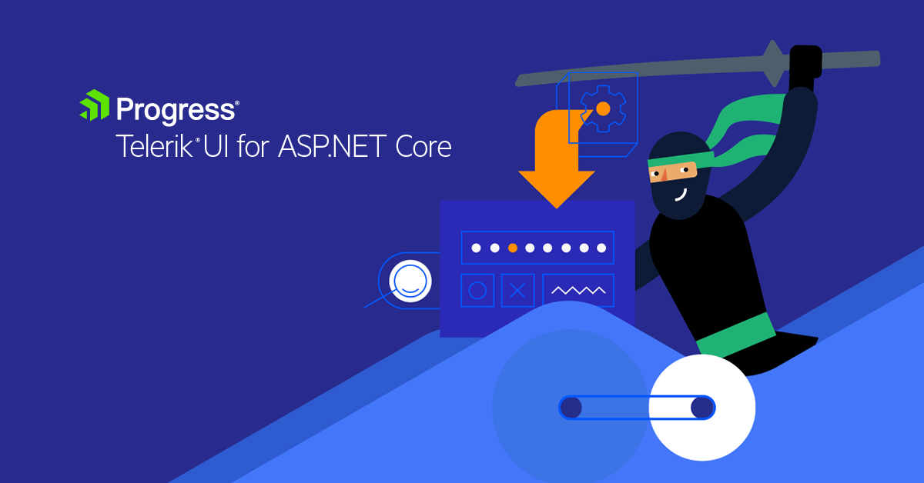
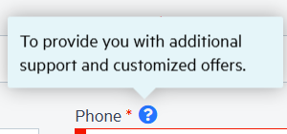

ACCOUNT
CONTACT US
Empty field
Symbols
Change email button
Tooltip: phone number field, country fields
Empty fields: password, country
7 methods
Valid input
Empty fields
Special chars and symbols
Tooltip
Invalid
11 methods

Slide 6

To Tests Github

Slide 7


THANK YOU

